Slide 1
Paper and code analysis of Global and Local Kernels for Recommender Systems
Md. Baker, ID- 1911672642
Kazi Kaarima Nashia, ID-2031176642
Fatema Akter Rimi, ID-2021930042

Slide 2
Github link
https://github.com/usydnlp/Glocal_K?fbclid=IwAR2Ep8jdl58xI2pnhlSTQEdWlFScbpNxpHl9UznOVUXjm2YXUyzYuo_gP

Slide 3
Motivation
Recommender systems often deal with high dimensional sparse user-item matrix
For a system to predict a user’s interest, it becomes imperative to complete these matrices
Hence, this paper proposed a Global Local Kernel based matrix completion framework named GLocal-K

Slide 4
Aim of this paper
To represent high dimensional sparse user item matrix into low dimension with a small number of important features
This will be achieved by GLocal K framework
Next , to improve the feature extraction performance for a high dimension user-item rating matrix into low dimensional latent feature space
To extract the features, 2 kernels are used: local kernel and global kernel

Slide 5
Global Kernels:
Global kernels in recommender systems typically refer to models or techniques that consider the overall user-item interaction matrix or a global representation of user-item interactions.
These kernels capture general patterns or relationships across all users and items in the recommendation dataset. They aim to provide a broad understanding of user preferences and item characteristics.
Common global kernel techniques include matrix factorization, collaborative filtering, and singular value decomposition (SVD). These methods aim to factorize the user-item interaction matrix into latent factors to make recommendations.
Local Kernels:
Local kernels focus on capturing localized patterns or relationships within specific subsets of user-item interactions. Instead of considering the entire dataset, they concentrate on smaller, more specialized segments.
Local kernels can be used to address issues such as user cold-start problems (where there is limited data on a new user) or item cold-start problems (where there is limited data on a new item) by considering interactions within specific user or item clusters.
Techniques like content-based filtering, neighborhood-based methods, and context-aware recommendation systems often incorporate local kernels to provide recommendations based on the local context.

Slide 6
2 major stages of GLocal K
Pretrain an autoenoder
Fine tune the pre-trained auto-encoder

Slide 7
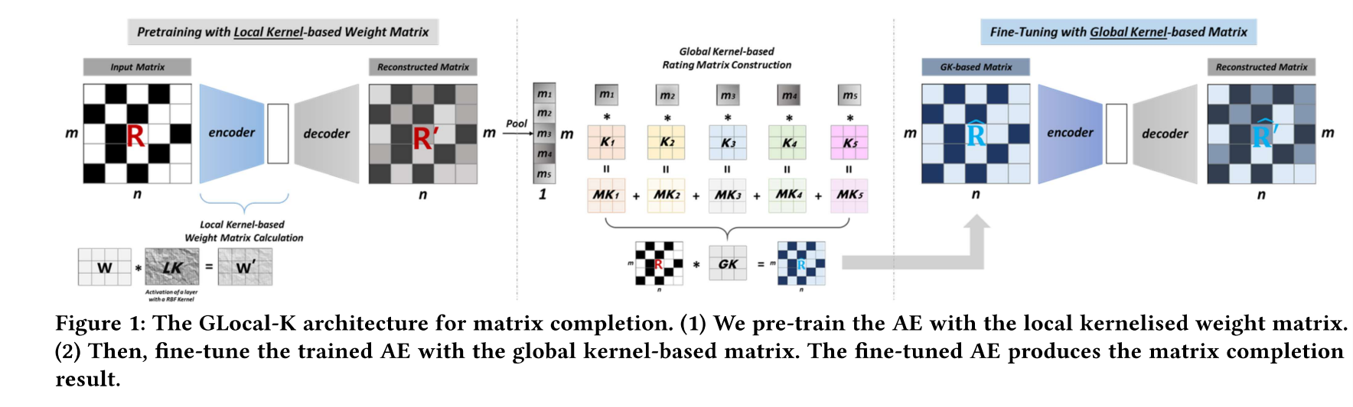
Diagram of the process

Slide 8
Implementation of each of these stages

Slide 9

Stage1: Pretrain an autoencoder
Each item vector r_{i} are inputs to item based autoencoder and gives the reconstructed vector r_{i} prime to predict the missing ratings
The model is given by:
Where 𝑊^ (𝑒) ∈ R^ (ℎ×𝑚) and 𝑊 ^ (𝑑) ∈ R^ (𝑚×ℎ) are weight matrices,𝑏 ∈ R^ ℎ and 𝑏 ′ ∈ R^ 𝑚 are bias vectors, and 𝑓 (·) and𝑔(·) are non-linear activation functions.

Slide 10

Continuing
The weight matrices in an autoencoder are reparametrized to generalize weight matrices by RBF Kernel
The RBF is defined as:
Here ,K is a kernel function which computes the similarity between two vectors U and V
After this, the next step will be to compute the local kernelized matrix

Slide 11

Computing local kernelized matrix
The dot product of weight matrix and kernel function will give local kernelized matrix

Slide 12
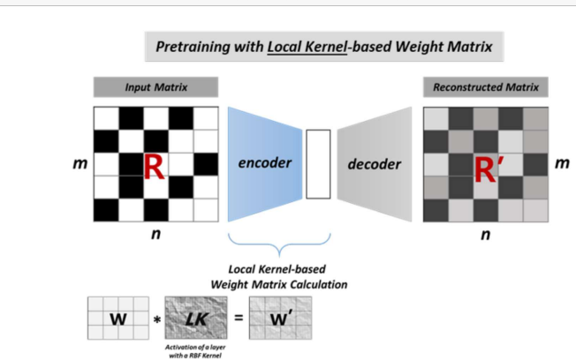
Diagram of stage 1

Slide 13
Intermediate stage
In this stage, the output of the decoder( in this case, rating matrix)
is passed to pooling to summarize the information of each item
The kernels are aggregated
These aggregated kernels are used as global convolution kernel
Global kernel based convolution operation is applied to user rating matrix for global kernel based feature extraction

Slide 14
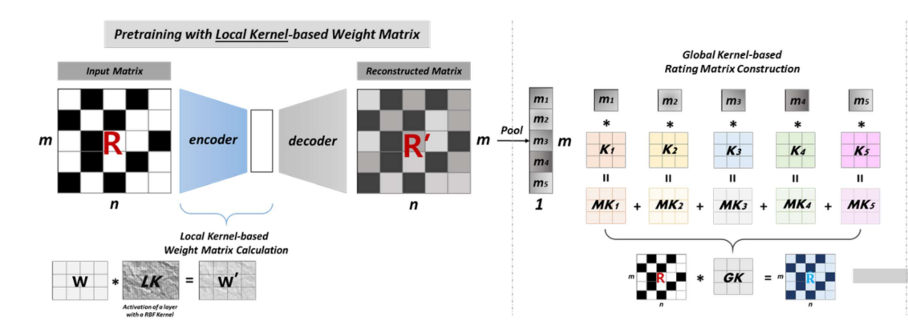
Diagram of intermediate stage

Slide 15
2. Fine tuning with global kernel
Global kerned based rating matrix is given as input to the pre-trained model
The output of the model corresponds to the final predicted ratings for matrix completion

Slide 16
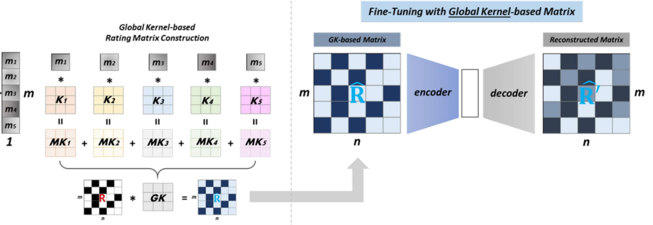
Diagram of stage 2

Slide 17
Experiments
Conducted experiment on 3 datasets: MovieLens-100K, MovieLens-1M and Douban
Compared the RMSE of Glocal with 11 recommendation baselines

Slide 18
Hyperparameters
500 dimensions for AE
2 hidden layers
5 dimension vectors for RBF kernel
3 by 3 global convolution kernel

Slide 19
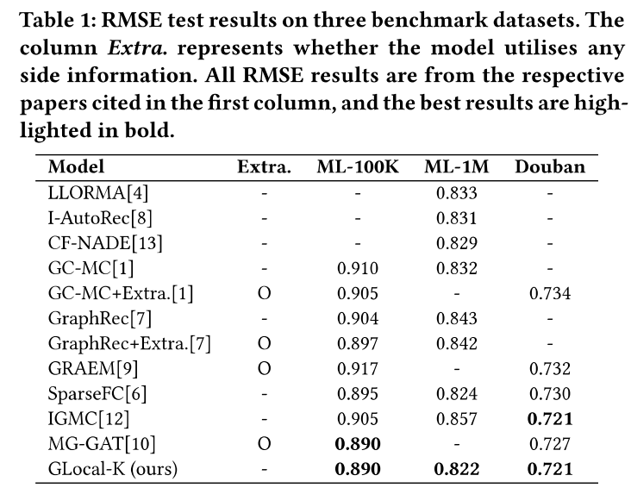
Results-comparing RMSE

Slide 20
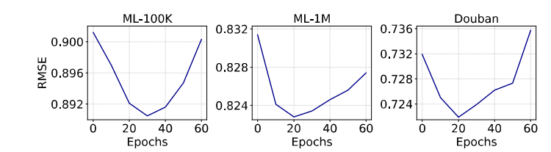
Performance comparison on the no of epochs

Slide 21
Thank You

